Slide 1
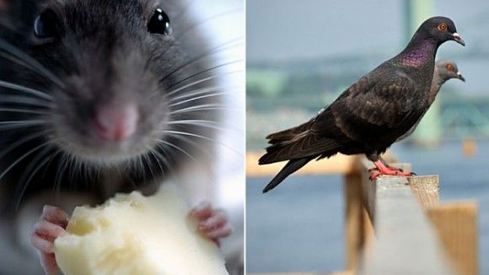
Mixed Models for Animal Models:
A Quick, Practical Introduction in R
Olga Lazareva
Drake University

Slide 2


LMM and GLMM
Or:
How
I Learned
To
Stop
Worrying
And
Love
Statistics
$$y=Xβ+Zu+ε$$
https://www.imdb.com/title/tt0057012/mediaviewer/rm3960095232/?ref_=tt_ov_i

Slide 3
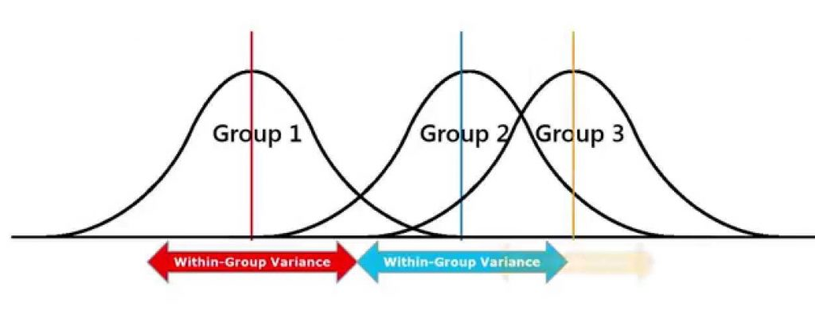
Why do I need fancy stats?
Animal cognition: What do we measure?
  Choices: Binary (0/1)
  Latencies and counts: Positively skewed, long tailed
PROBLEM 1: Parametric statistics require interval or ratio, continuous, normally distributed data
Solution 1: Nonparametric tests
  Loss of power
Solution 2: Aggregate across trials to convert to percent correct or transform to achieve normality
https://www.leansixsigmadefinition.com/wp-content/uploads/2019/03/anova_charts-e1578120944898-1024x395.jpg

Slide 4


Problem with aggregating across trials
DEMO 1
Percent correct does not behave as a true continuous variable
  Bounded from 0 to 1
  Variance isn’t constant (high in the middle, low near floor or ceiling)
  Often not normally distributed
Decisions about how many trials should be averaged are arbitrary
Continuous variable (block, day) is treated as categorical
All leads to loss of power and frustrating results
https://static.vecteezy.com/system/resources/previews/049/056/343/non_2x/confused-city-pigeon-is-thinking-with-question-mark-vector.jpg

Slide 5

Stop forcing binary data into normal distribution mold…
…and learn to love GLMM…
…which is simply regression
Outcome = Intercept + slope × IV
Random effects
  Different starting points → Random intercepts
  Different learning rates → Random slopes
LMM assumes normality
GLMM matches model to the data
  Binary choice data → Binomial distribution
https://leadershipandmain.org/wp-content/uploads/2025/03/square-peg-round-hole.png

Slide 6

Same data, better analysis
DEMO 2
Intercept: Fast group on trial 0
  Log-odds -1.41, ≈ 19%
Trial_new: Slope for the Fast group
  Over 100 trials, log-odds increase by 2.27
  From ≈ 19% at trial 0 to 70% on trial 100
Conditionslow: Difference in intercept between Fast and Slow
  ≈ 6%
Trial_new:conditionslow: Difference in slopes between Fast and Slow
  Log-odds: 2.26-1.0 =1.26
  From ≈ 14% at trial 0 to 36% on trial 100
OUTPUT
Fixed effects:
Estimate Std. Error z value Pr(>|z|)
(Intercept) -1.4078 0.4408 -3.194 0.0014 **
trial_new 2.2669 0.1405 16.135 < 2e-16 ***
conditionslow -0.3880 0.6174 -0.628 0.5297
trial_new:conditionslow -1.0287 0.1554 -6.621 3.57e-11 ***

Slide 7
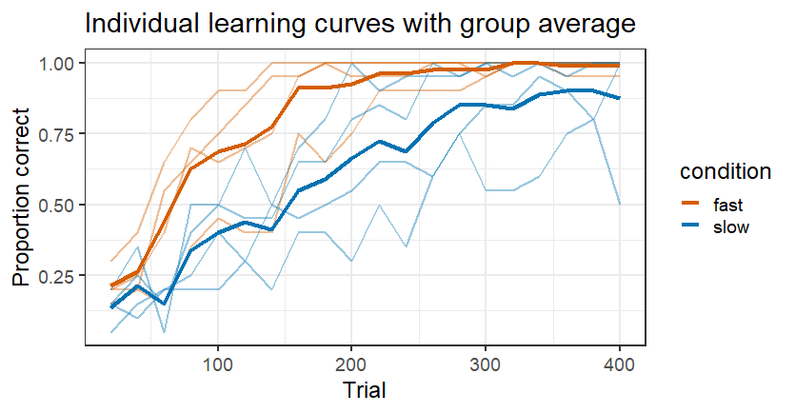
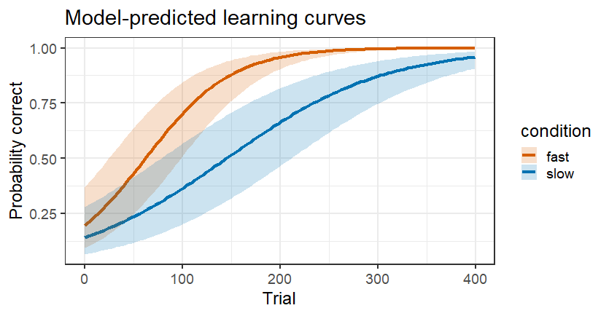
Why is this better?
DEMO 2
Tests the actual question: Do groups learn at different rates?
Matches model to the data
Trial-level data: More power
One test: No post-hoc fishing
No arbitrary decisions
  How to bin, which comparisons to test, what to do when some animals learn over fewer trials

Slide 8
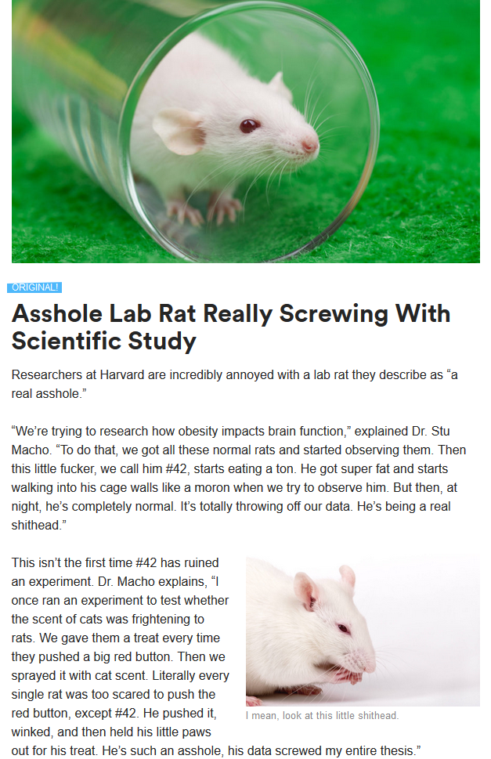
But wait! It gets better!
https://steemit.com/asshole/@thedegensloth/asshole-lab-rat-really-screwing-with-scientific-study

Slide 9
PROBLEM 2: Individual differences
DEMO 3
Intercept: Training performance
  2.78 log odds, ≈94%
phaseBD: drop from training performance
  2.8-1.8, ≈70%
phaseAE: smaller drop from training performance
  2.8-1.7, ≈75%
BACK to DEMO 3
Fixed effects:
Estimate Std. Error z value Pr(>|z|)
(Intercept) 2.7799 0.3532 7.870 3.55e-15 ***
phaseBD -1.8821 0.3408 -5.523 3.33e-08 ***
phaseAE -1.6851 0.3473 -4.852 1.22e-06 ***
---
Signif. codes: 0 ‘***’ 0.001 ‘**’ 0.01 ‘*’ 0.05 ‘.’ 0.1 ‘ ’ 1

Slide 10
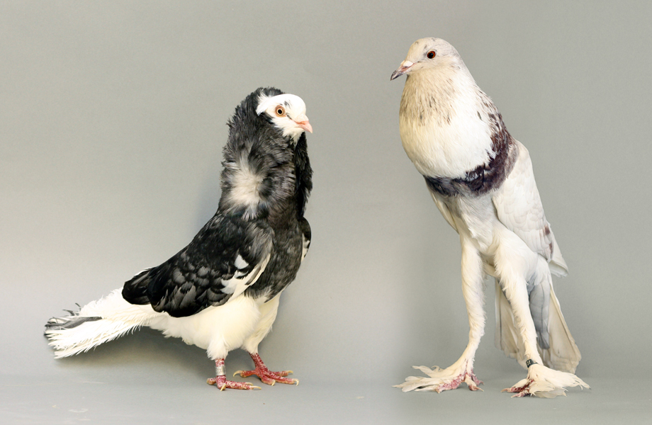
Why GLMM handles individual differences better
ANOVA averages out individual differences as noise
GLMM asks: How does this effect vary across individuals?
  Fixed effects: True on average
  Random effects: Individual variability
  Allows to see the pattern AND the exceptions
https://learn-genetics.b-cdn.net/pigeons/other/images/Proportion.jpg

Slide 11
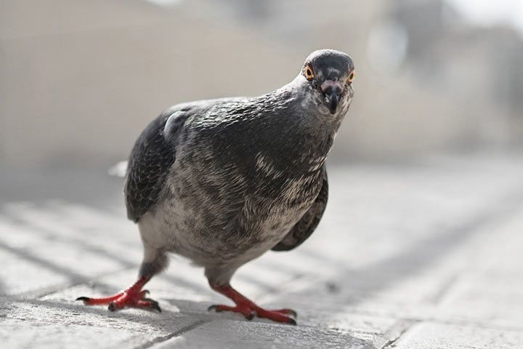
Why use GLMM?
Uses data as collected
  No averaging, no percent change, no arbitrary decisions
  Handles incomplete data
Handles continuous variables
  No posthoc fishing
Matches model to the data
  Binary → binomial, counts → Poisson/negative binomial, latencies → Gamma/inverse Gaussian, etc.
Handles individual differences
  No need to remove “outliers”
Allows to investigate diverse individual strategies in absence of group effect
Instead of making data behave, use the model that understands behavior of your data
https://www.animalfunfacts.net/images/stories/photos/birds/pigeons/pigeon/pigeon_curious_l.jpg

Slide 12
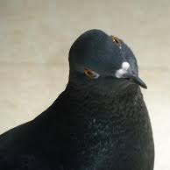
Okay, now what?
Do I have to use R?
  Mixed models are also available in SPSS, JASP, etc.
  But, R is most flexible and diverse
Where do I learn R?
  Google, StackOverflow, ChatGPT (yes, really), RStudio tutorials
Start small. Copy code. Break things. Ask for help.

